Slide 1





#mi_attitude
www.facebook.com/glennhinds
@glennhinds
Glenn Hinds
www.glennhinds.com

Slide 2




Talking To Change:
A Motivational Interviewing Podcast
Notes:
Share this link in chat https://www.glennhinds.com/category/podcast/

Slide 3
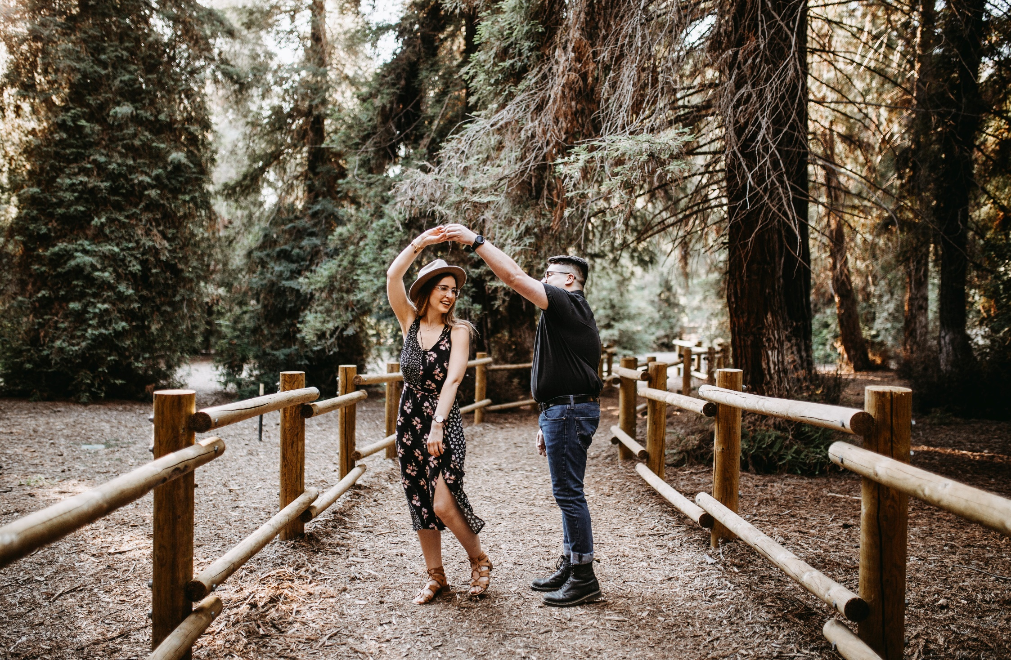
Seminar One: SPIRIT

